Slide 1
Tuesday, August 28, 2012
TISK Problems
Draw a scatter plot with a positive correlation. Write a sentence describing the correlation and label your axes appropriately.
Find the constant difference: 22, -8, -10, -88, 22, 152, 502
Which difference was the constant difference in problem #2?
There will be 3 Mental Math questions today.
Homework: Worksheet 2.5
Notes:
Mental Math
Start with the smallest prime number that is a factor of 55. Square it. Double it. Subtract 2. Double it. (96)
Start with the smallest prime number that is a factor of 77. Square it. Double it. Add 2. Double it. (200)
Start with the smallest prime number that is a factor of 121. Square it. Double it. Subtract 2. Double it. (480)

Slide 2
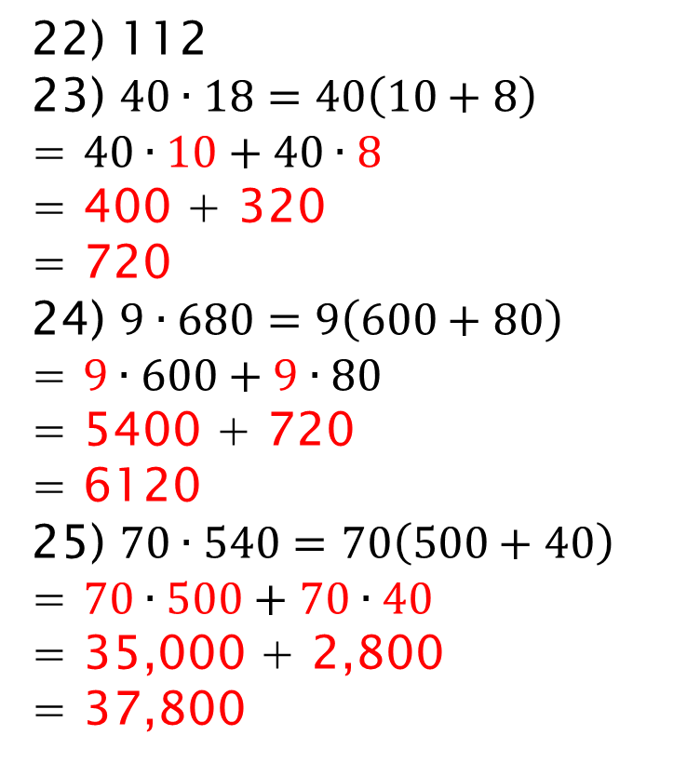
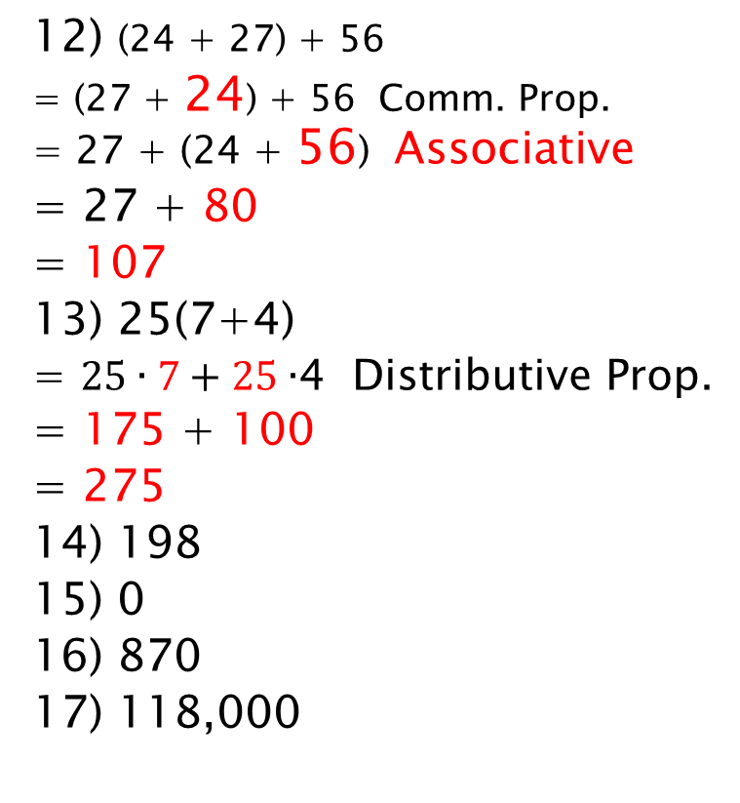
Homework Check
12) (24 + 27) + 56
= (27 + 24) + 56 Comm. Prop. = 27 + (24 + 56) Associative
= 27 + 80
= 107
13) 25(7+4)
= $25∙7+25∙$4 Distributive Prop.
= 175 + 100
= 275
14) 198
15) 0
16) 870
17) 118,000
22) 112
23) $40∙18=40\left(10+8\right)$
= $40∙10+40∙8$
= 400 + 320
= 720
24) $9∙680=9\left(600+80\right)$
= $9∙600+9∙80$
= 5400 + 720
= 6120
25) $70∙540=70\left(500+40\right)$
= $70∙500+70∙40$
= 35,000 + 2,800
= 37,800

Slide 3
§2.5 Continued
Using the Distributive Property
Simplify: 4(x + 5)
= 4(x) + 4(5)
= 4x + 20
You try it. Simplify: 3(x – 8)
= 3(x) + 3(-8)
= 3x + (-24)
= 3x – 24

Slide 4
§2.5 Continued
Use the Distributive Property to write equivalent expressions for each expression below.
-6(3r – 9)
= -6(3r) + (-6)(-9)
= -18r + 54
8y + 28xy
= 4(2y + 7xy)
= 4y(2 + 7x)

Slide 5
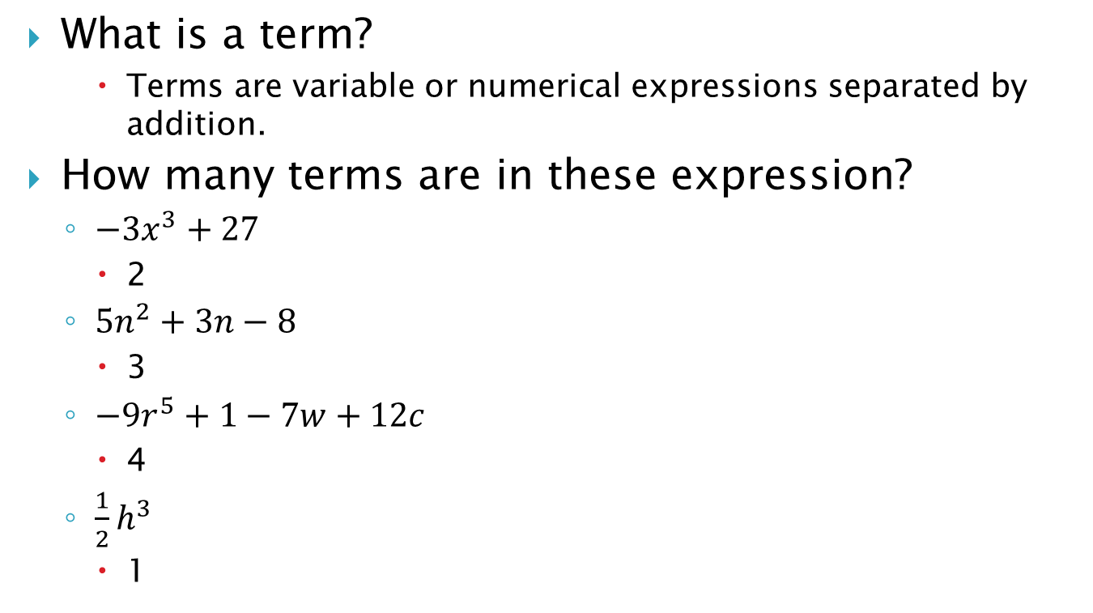
Opposite of an Expression
What is a term?
Terms are variable or numerical expressions separated by addition.
How many terms are in these expression?
$−3x^{3}+27$
2
$5n^{2}+3n−8$
3
$−9r^{5}+1−7w+12c$
4
$\frac{1}{2}h^{3}$
1

Slide 6
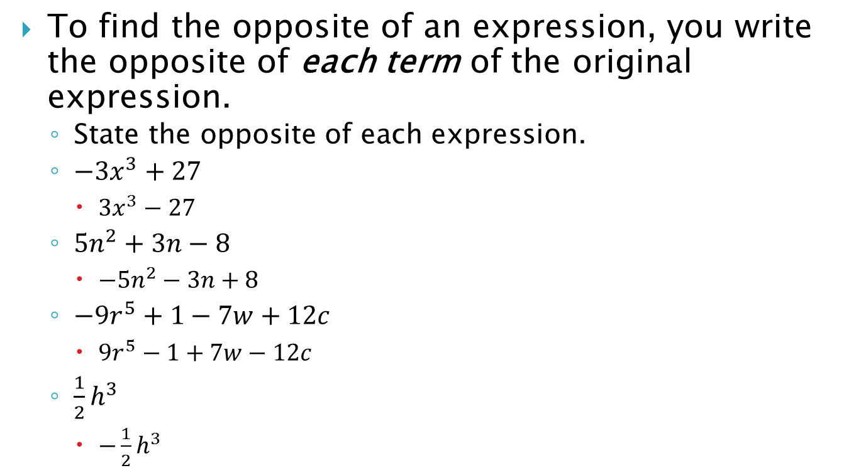
Opposite of an Expression
To find the opposite of an expression, you write the opposite of each term of the original expression.
State the opposite of each expression.
$−3x^{3}+27$
$3x^{3}−27$
$5n^{2}+3n−8$
$−5n^{2}−3n+8$
$−9r^{5}+1−7w+12c$
$9r^{5}−1+7w−12c$
$\frac{1}{2}h^{3}$
$−\frac{1}{2}h^{3}$

Slide 7
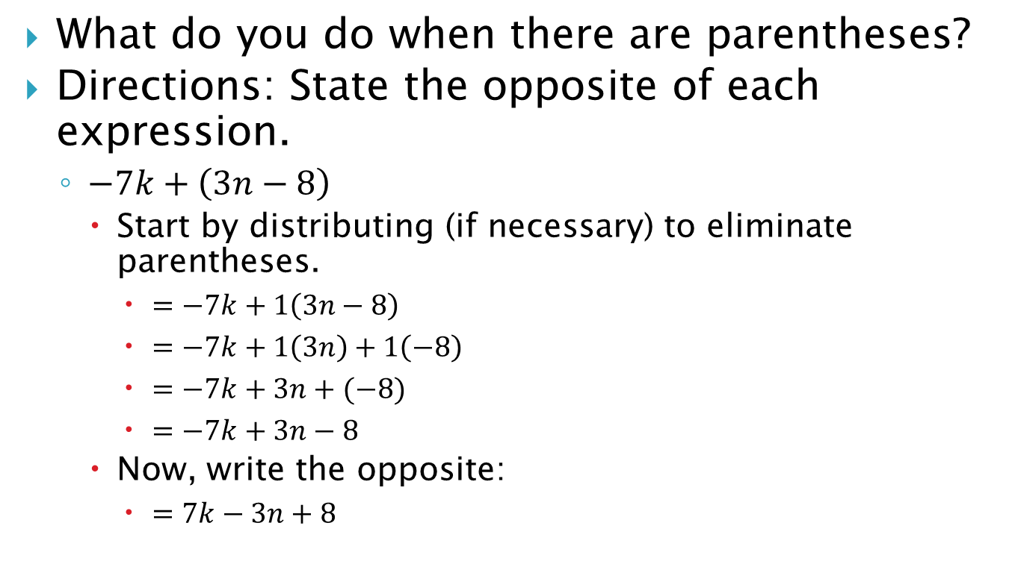
Opposite of an Expression
What do you do when there are parentheses?
Directions: State the opposite of each expression.
$−7k+\left(3n−8\right)$
Start by distributing (if necessary) to eliminate parentheses.
$=−7k+1\left(3n−8\right)$
$=−7k+1\left(3n\right)+1\left(−8\right)$
$=−7k+3n+(−8)$
$=−7k+3n−8$
Now, write the opposite:
$=7k−3n+8$

Slide 8
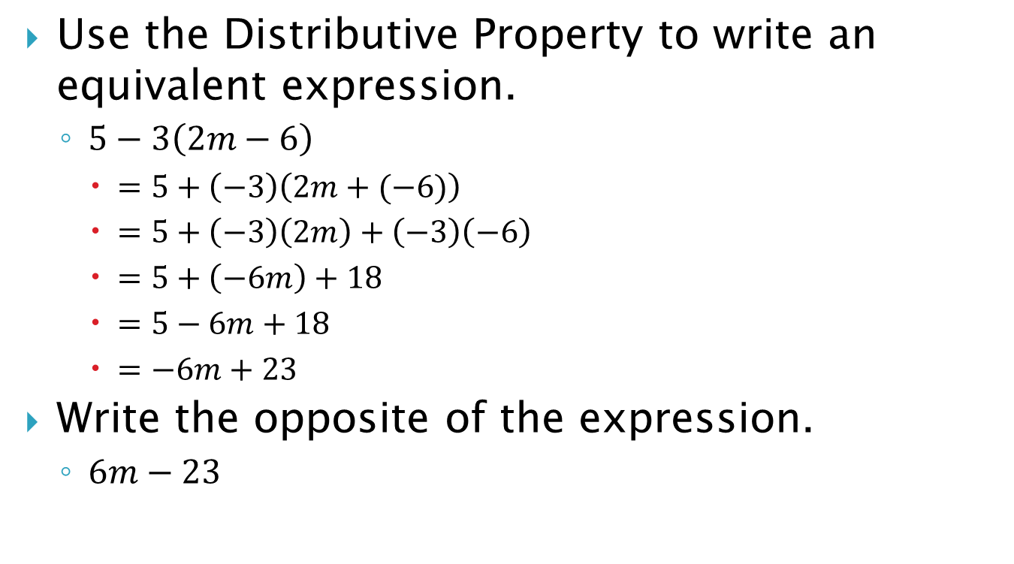
The “Tricky” Ones…
Use the Distributive Property to write an equivalent expression.
$5−3\left(2m−6\right)$
$=5+\left(−3\right)\left(2m+(−6)\right)$
$=5+\left(−3\right)\left(2m\right)+\left(−3\right)\left(−6\right)$
$=5+\left(−6m\right)+18$
$=5−6m+18$
$=−6m+23$
Write the opposite of the expression.
$6m−23$

Slide 9
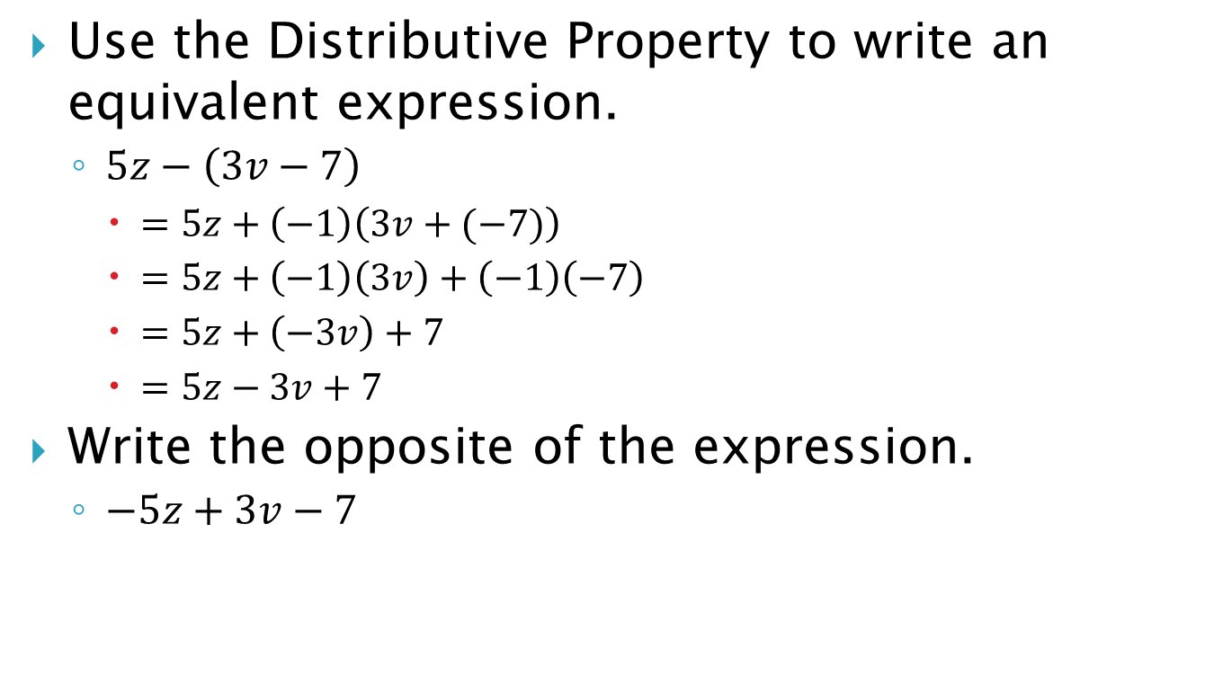
The “Tricky” Ones…
Use the Distributive Property to write an equivalent expression.
$5z−\left(3v−7\right)$
$=5z+\left(−1\right)\left(3v+(−7)\right)$
$=5z+\left(−1\right)\left(3v\right)+\left(−1\right)\left(−7\right)$
$=5z+\left(−3v\right)+7$
$=5z−3v+7$
Write the opposite of the expression.
$−5z+3v−7$

Slide 10
Homework
Worksheet 2.5
Make sure to show ALL WORK in a neat and organized fashion ON THE WORKSHEET.

